Slide 1
Mathematical Foundations for Machine Learning
MFML Team

Slide 2
S2 -22 AIMLCZC416, MFML
Webinar#4

Slide 3
Agenda
Some important vector identities
Derivation of learning rate Tau for quadratic form
Problem on KKT Condition
Problem on Dual Problems
Problem on Slater’s Conditions

Slide 4
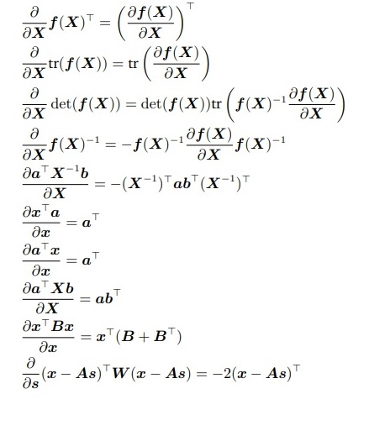
Vector Identities for Computing Gradients
W A for symmetric W

Slide 5
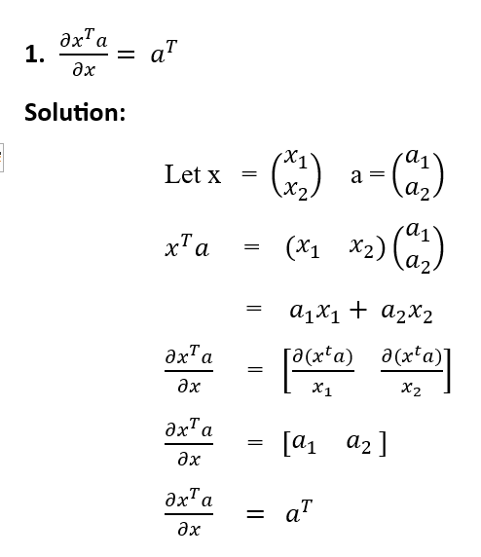
Vector Identities

Slide 6
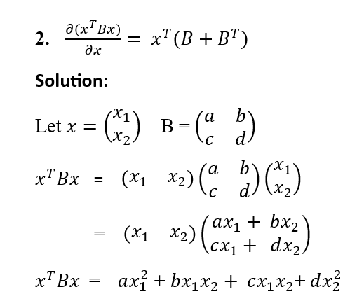
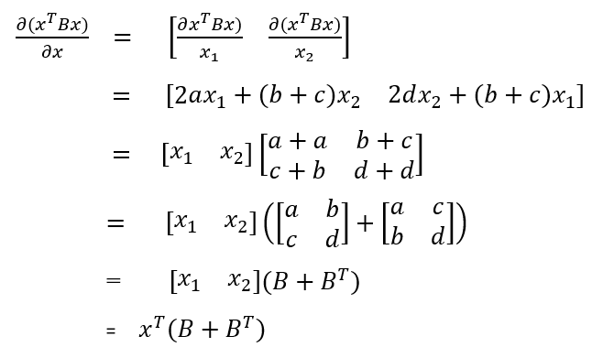

Slide 7

Suppose we want to minimize the quadratic function:
This is equivalent to solve linear problem:
Let the iterative formula for minimum point be
Where be the step size

Slide 8
Let

Slide 9

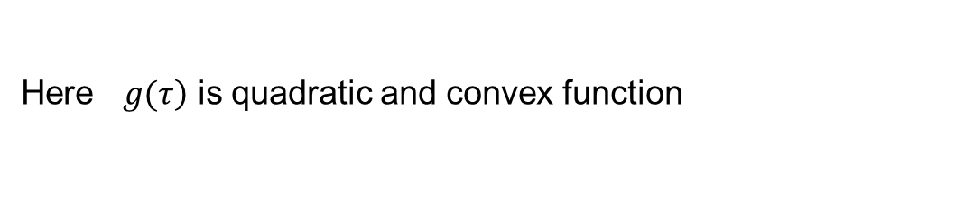
Here $\left.g(τ\right)$ is quadratic and convex function
Condition for extrema of $\left.g(τ\right)$ is

Slide 10
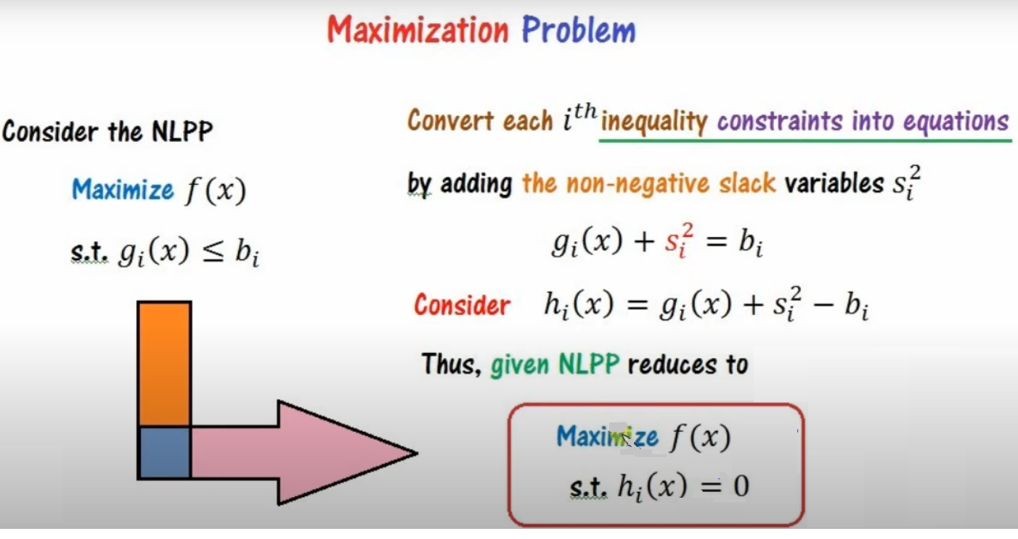
Non-linear Optimization

Slide 11
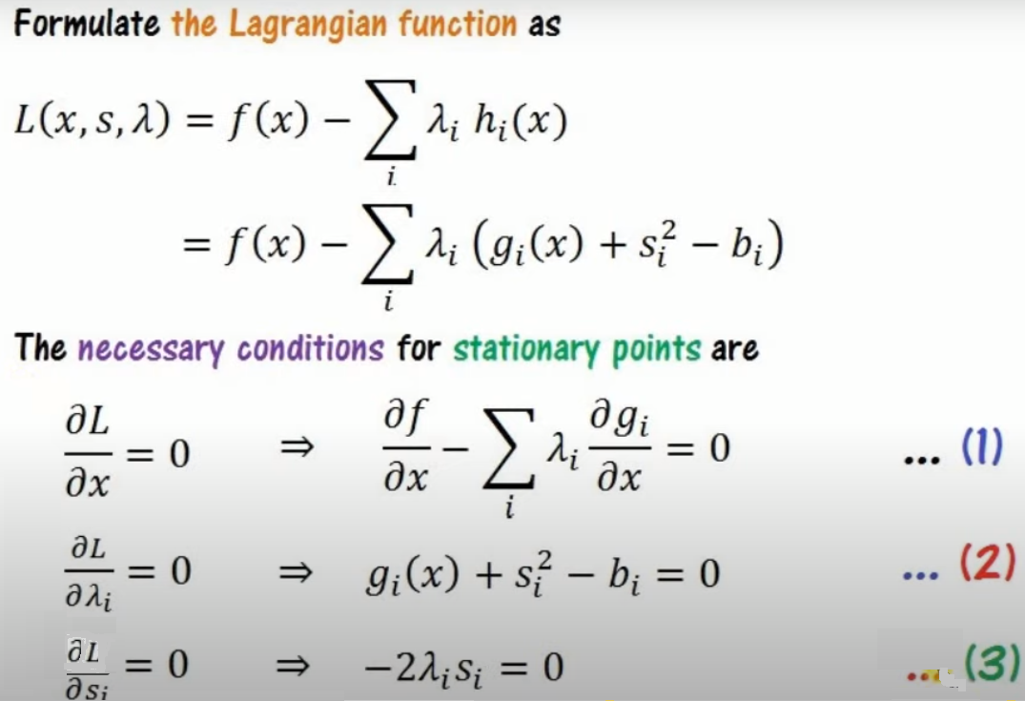

Slide 12
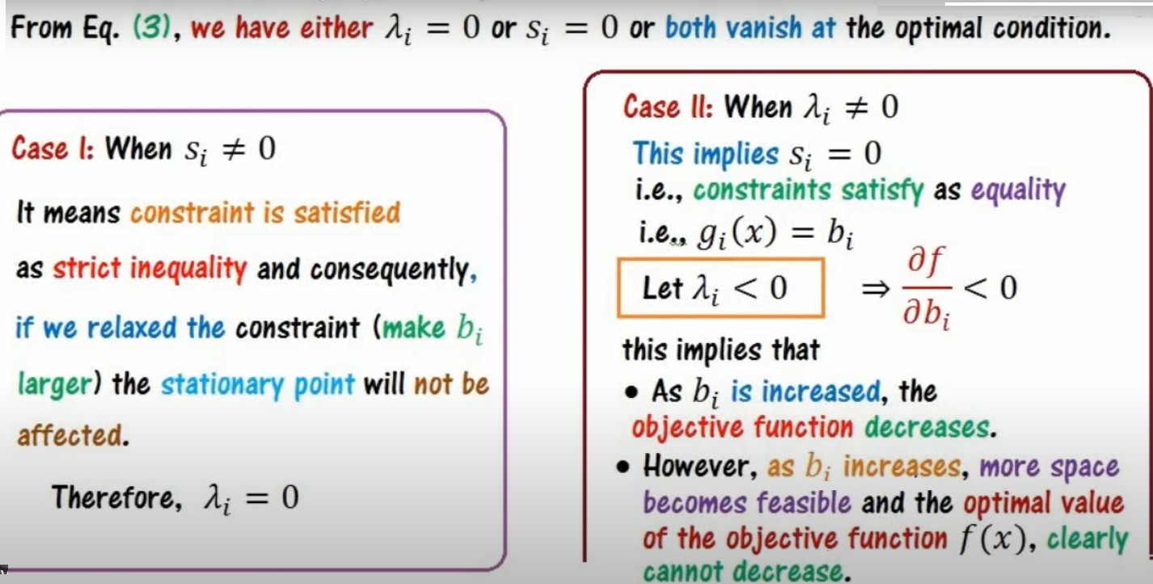

Slide 13
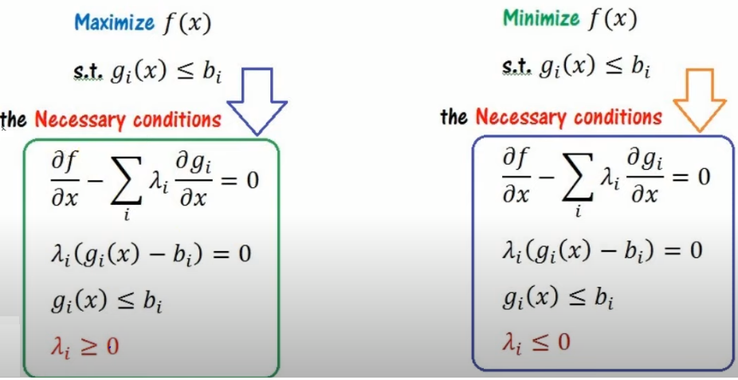
Nonlinear Programming Problem –KKT conditions

Slide 14
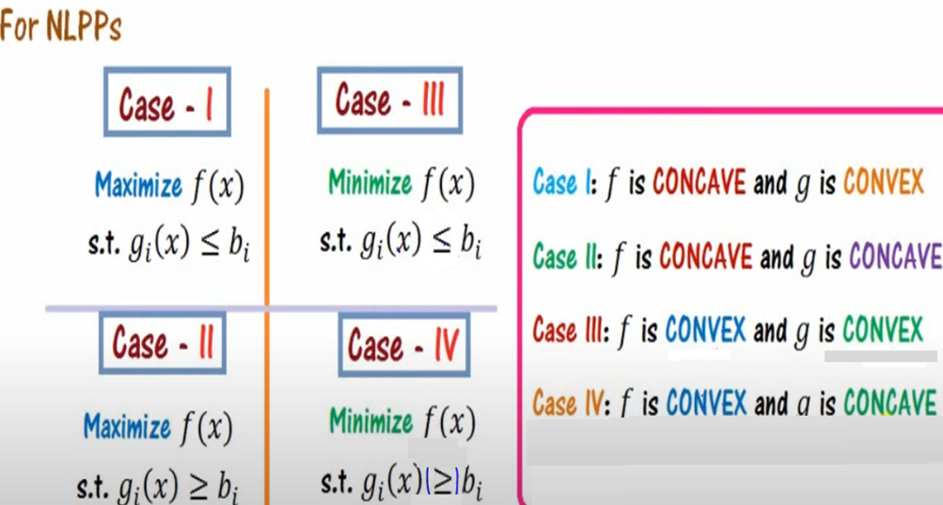

Slide 15
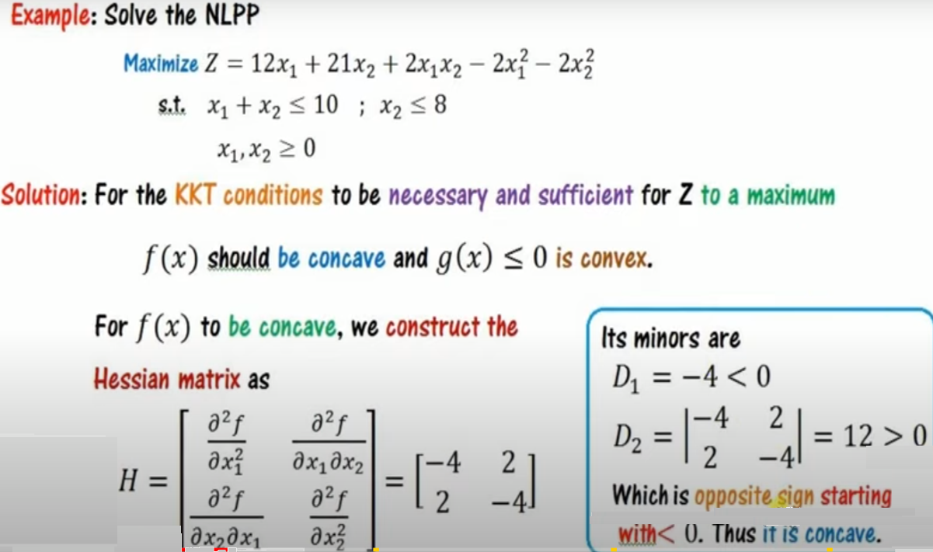

Slide 16
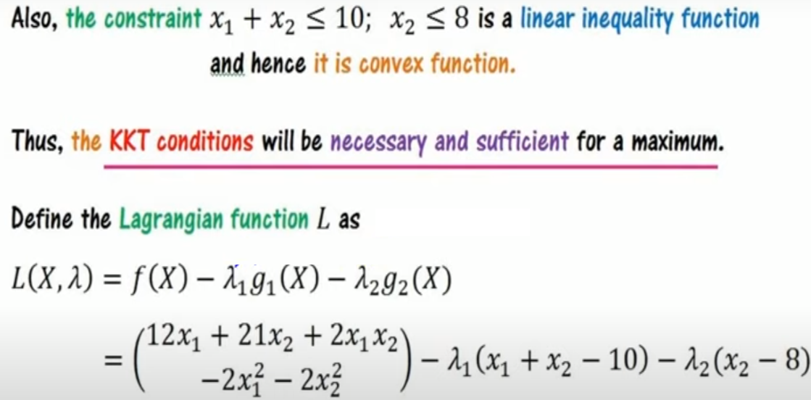

Slide 17
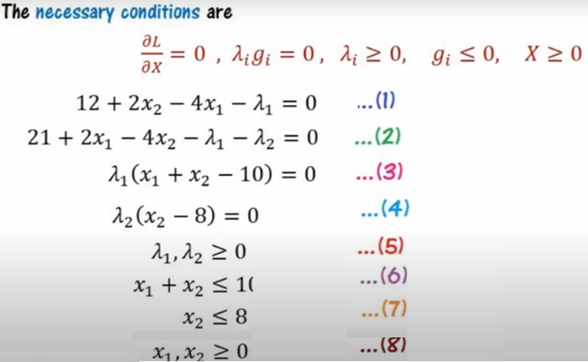

Slide 18
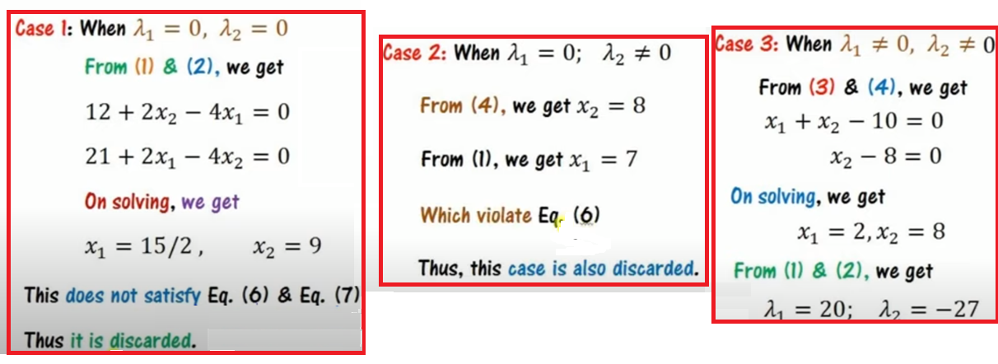

Slide 19
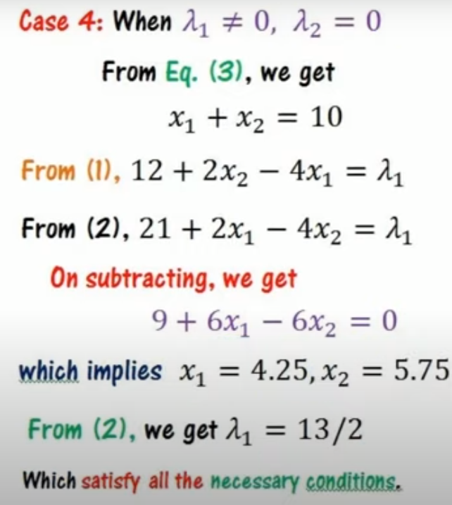
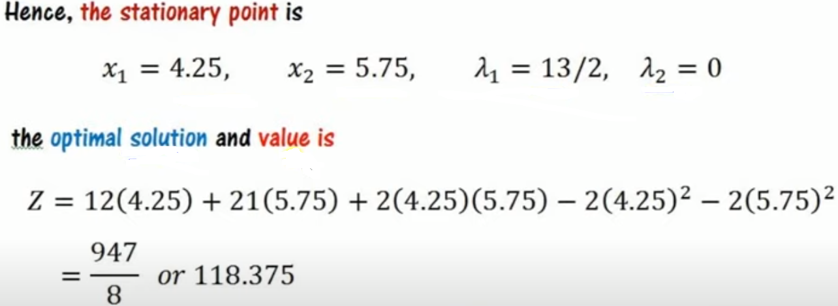

Slide 20
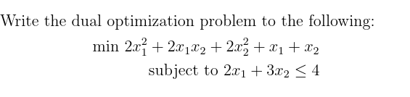
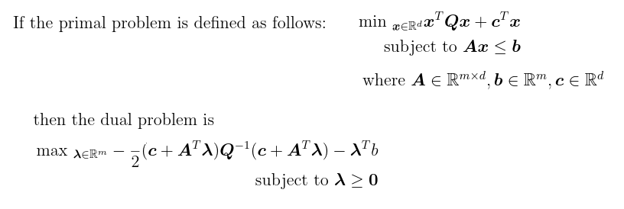
Solution:

Slide 21
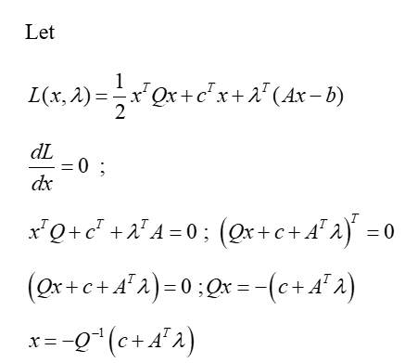
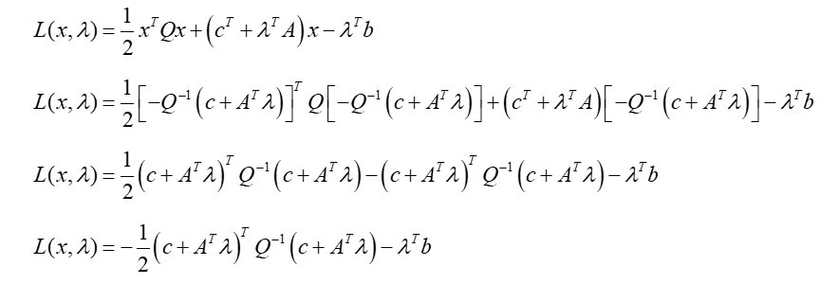

Slide 22
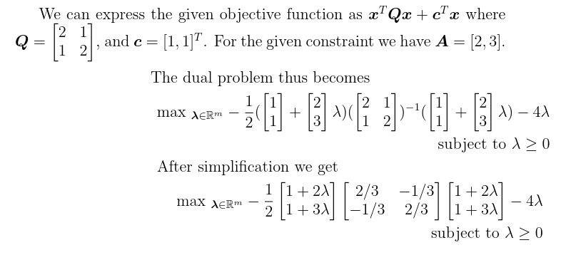

Slide 23
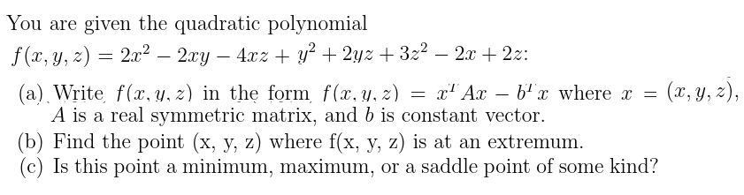
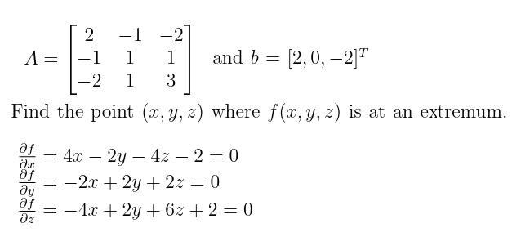
Solution:

Slide 24
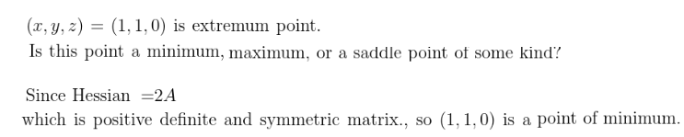

Slide 25
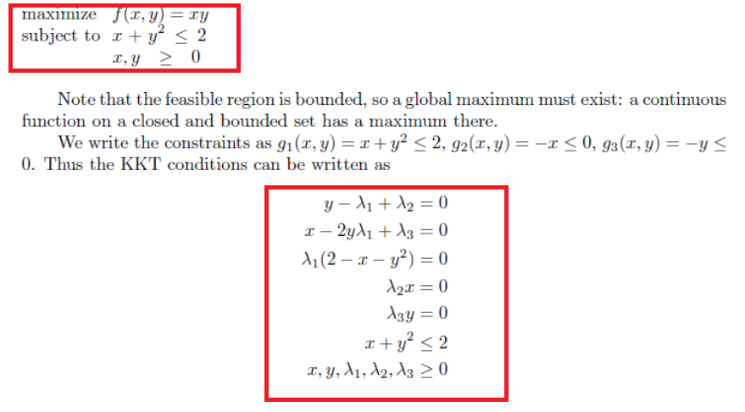
Homework Problems
Example:

Slide 26
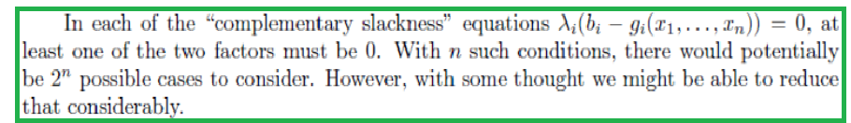
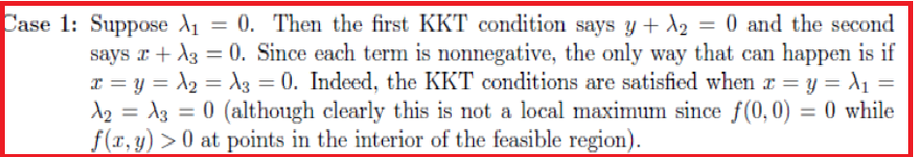

Slide 27
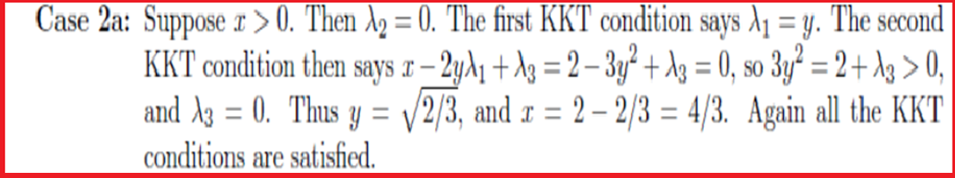
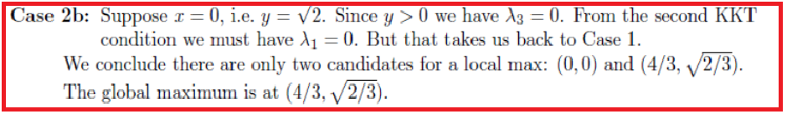
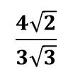
Maximum value is:
$$\frac{4\sqrt{2}}{3\sqrt{3}}$$

Slide 28
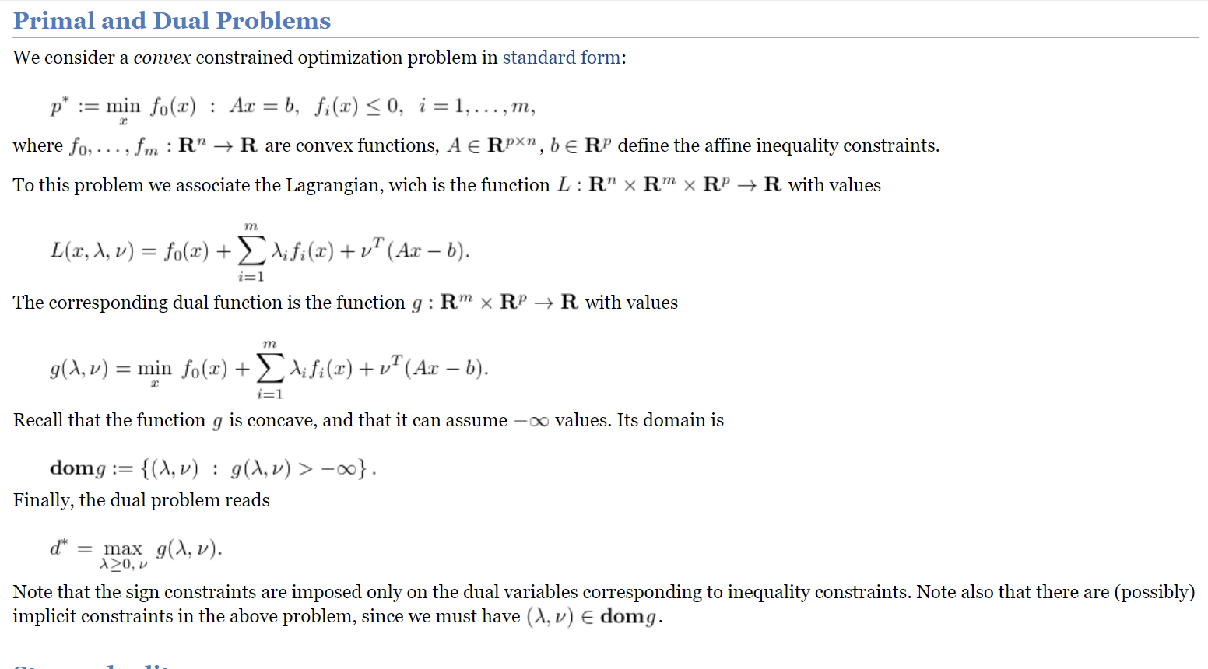

Slide 29
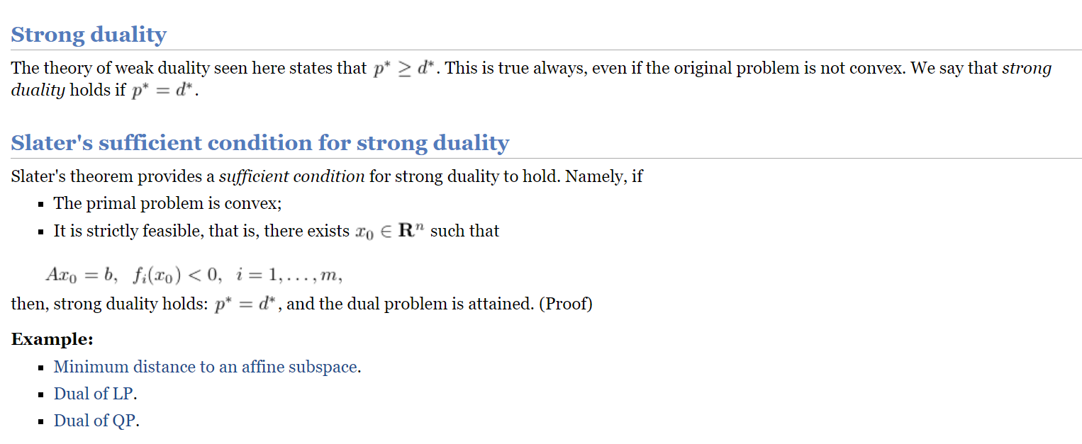
.

Slide 30
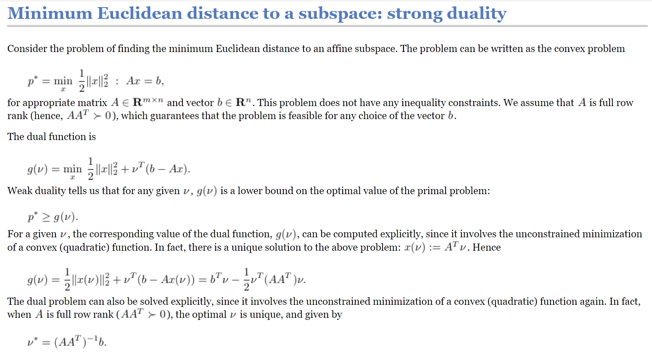
Example 1:

Slide 31
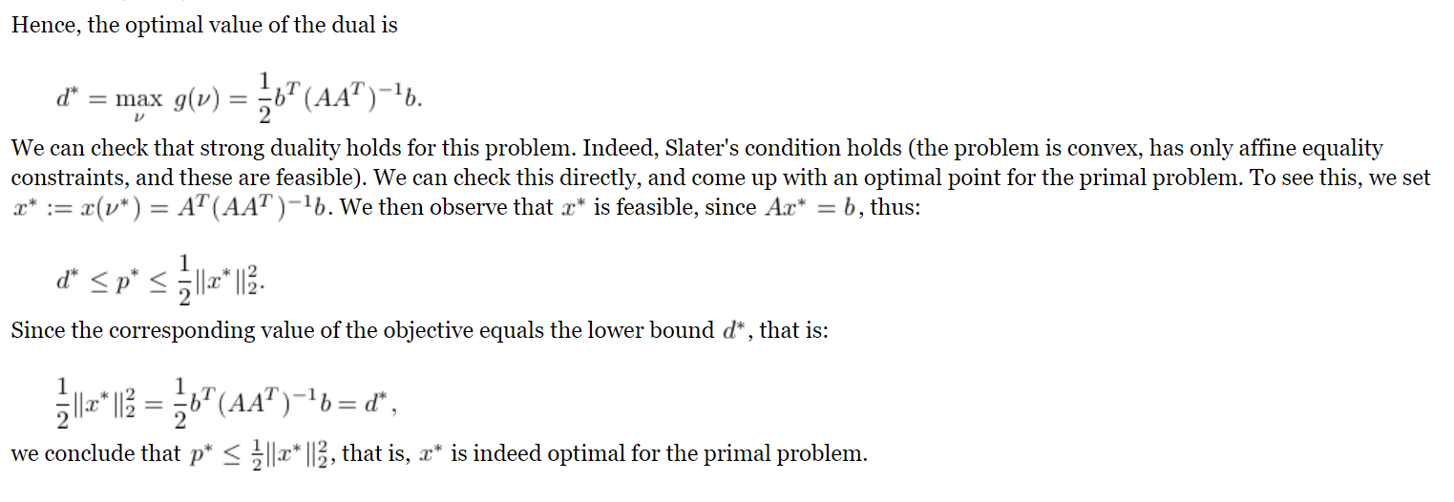

Slide 32
Thank You

